Slide 1
Applicant Loan Prediction Using Random Forests and Decision Trees
Saif Awan, Param Patel

Slide 2
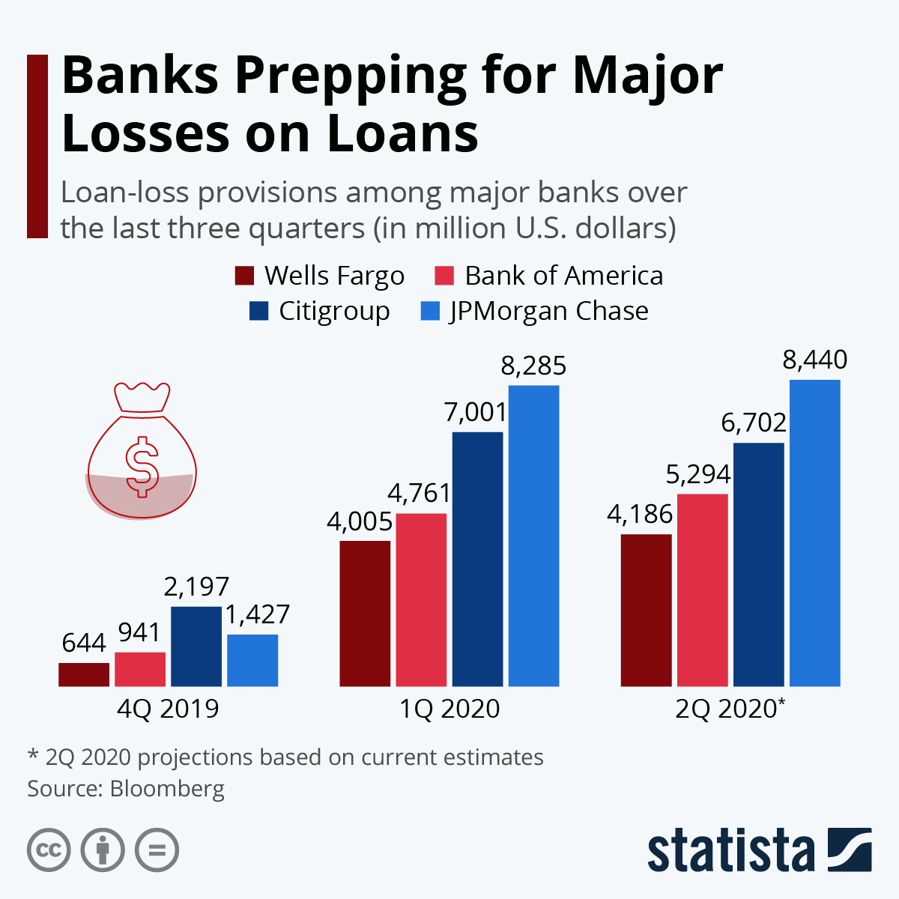
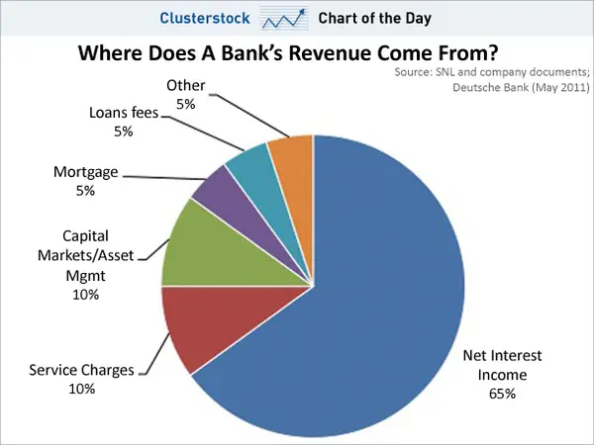
Problem Statement
Notes:
Due to COVID19 many banks are preparing to deal with loan defaults do to unforeseen circumstances. As amatuer data scientists we wanted to explore how banks approve applicants for loans and which variables they take into account for applications.

Slide 3
Technical Challenges
Accurately Identifying the Problem
Making use of data properly
Data Preparation
Notes:
80% of the time data scientist are processing data

Slide 4
Related Works
In our project, we came across an article called Monetary Loan Eligibility Prediction using Machine Learning, which used variety of algorithms to determine which one is the best fit.

Slide 5
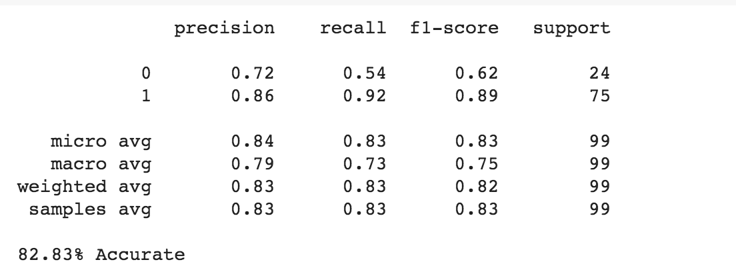
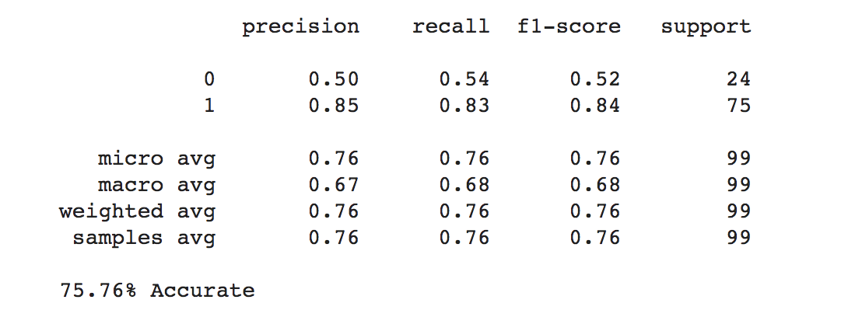
Our Approach and Results
Random Forests
Decision Trees

Slide 6
Broader Impact

